Slide 1

Level Up Your RPG
with Python
Joseph Wright @Wright4i
Notes:
Title, Personal Introduction, Purpose of this Session
To show you some awesome Python packages that would make great additions to any RPG program. I’m thinking procedures in a service program to accomplish one off functions to really make your lives a lot easier.
This is like adding (good) recipes to your coding cookbook

Slide 2
Why you care?
SHOULD
It’s EASY
Stop reinventing the wheel (or saying I can’t) when you should start saying I can… in Python!
It’s FREE
The opensource community behind Python is incredibly strong and very open. With hundreds of thousands of free packages available you can usually find a quick solution to your problem in a package.
It’s COOL
And you will be too.
Notes:
It’s EASY –
Both the language itself is very easy to pickup, by design, and there’s such a wealth of knowledge online on python.org, youtube, stackoverflow, if you’re a fan of AI ChatGPT and Github CoPilot will be happy to teach you some python if you ask nicely.
(READ)
It’s Free
(READ)
The way I like to use Python is as a utility programming language. It’s important, I believe, to have many tools in your toolbox and knowing when to use each one. It’s too easy to write programs in a single language and put yourself in a situation where you just spend a week writing something from scratch when it could’ve been as simple as importing a package from Python and writing 2 lines of code.

Slide 3

The Tutorial
Connect to DB2
Install Python
SSH & PIP
Call from RPG
Python
Zelda
Notes:
So to start I wanted to teach you the legend of python.
I will go ahead and say this presentation is full of RPG jokes. I found it funny when I first started everytime I google’d for RPG all the results were about role playing games. So I’m going to play off of RPG and Leveling up because that’s the kind of nerd I am.
These next couple slides I’ll go a little quicker over. They are for anyone who’s never setup python before and might need some help. This slidedeck will be available later on the ocean website and on my github so I do hope it can serve as a reference for you later if you need it.
There’s been some great sessions already with Mike Pavalak that covered this and he’s doing another talk tomorrow at the workshop. I would highly recommend it for anyone who’s interested in more python and open source on the ibm i.

Slide 4
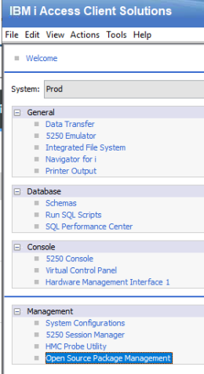
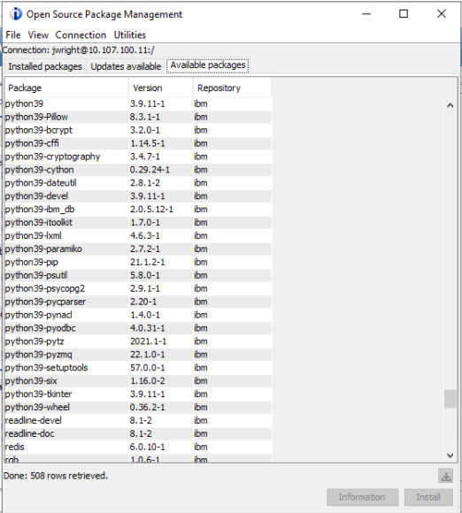
Installing Python
Use the Open Source Package Manager in ACS
Update your ACS to the latest version
Click Open Source Package Management
Sign in using SSH. (STRTCPSVR *SSHD if necessary).
Go to Available Packages
Select python39 and click install.
Notes:
(READ)
In the Open Source Package Manager you will also see python39 packages. It’s really important to know they exist here. If you see a package that you want installed you should always install this one in my experience as these have been validated and fixed for the IBM i. If you want you can go ahead and install all of them by just selecting multiple and hitting install.

Slide 5
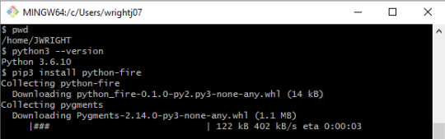
Using SSH and PIP
Git SCM (Git for Windows)
Using PIP
Bourne Again SHell (aka BASH)
ssh your_server
Or ssh ibmiuser@your_server
PIP is the package manager for python packages.
The command will be pip3 for python3
pip3 install package_name
Notes:
Once python has been installed you’ll want to SSH to your server to verify that installation.
Shells are a funny topic and in the open source community there are heated debated over what is best.
I like to recommend BASH to people. That’s the Bourne Again Shell and its available as part of GIT. So if you head over to GIT-SCM.COM and download it you’ll have both GIT and GIT BASH in just a few clicks. If you haven’t learned about GIT, you should, it’s a fantastic way to do source control management with open source and you can even host your code repository on the IBM I, but this talk isn’t about that so let me continue on…
(READ) SSH to your server…
Other valid methods would include PuTTY or QP2TERM though I wouldn’t recommend the latter if you can avoid it as not all the commands will render correctly and you lose a lot of quality of life features other shells can offer. Feel free to explore – On my linux development VM I use Oh My ZSH it looks great and has tons of advanced features and plugins. Like I said no right answer only “Not QP2TERM”
(READ) PIP

Slide 6
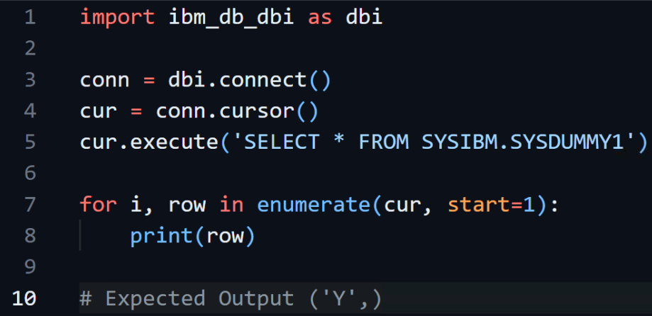
Connecting to DB2 from Python
Notes:
Quick Example how to connect using the ibm_db package. This is one of the package available from IBM themselves on the ACS Open Source Package Manager.
You might see other people like Mike Pavlak and Mark Irish who will use pyodbc. Also available in the ACS package manager. Both work.
(Walk through each line)

Slide 7
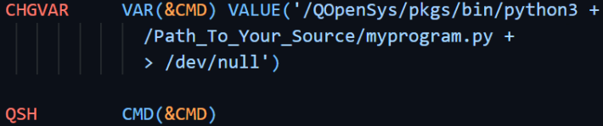
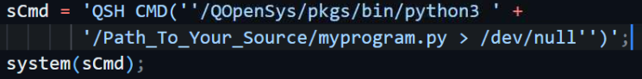
Running Python from CL/RPG (Quick and Dirty)
Notes:
Let’s be honest this is the way you’re going to start and that’s OK. In plenty of cases this enough and for getting started you just need to start calling some python code.
The top example is CL, the bottom in RPG. Notice in both you’re building a string to your python binary, adding a space, then a path to your python file you want to execute.
I do have one strange thing in this example you might not recognize and that’s the arrow to /dev/null. The short explanation is that redirects the output of python to nothing. It’s not ideal, but this is the quick and dirty so if you want to run code and don’t want it popping up strange screens with output (good/bad/otherwise) that’s how you do it.

Slide 8
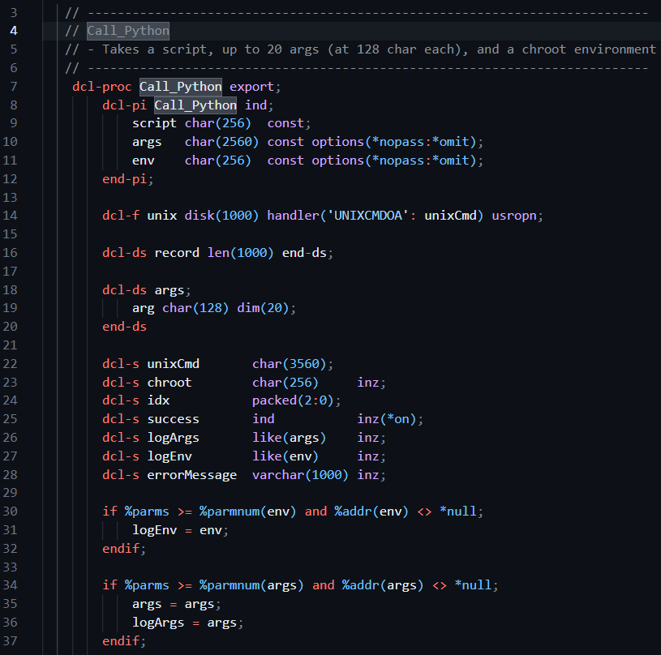
Running Python from RPG (Unix CMD, Chroot, Proc in SRVPGM) Pt 1
Notes:
This slide and next is an example of how I would do it the clean and proper way, but there’s a lot of approaches so if you’re taking python seriously you will want to customize and build your own procedure to call python.
Here I am using Scott Klemet’s UNIXCMD which is one method of getting the output from the shell called STDOUT so I can log it. CHROOT or Change Root is being used to sandbox and the calls are being logged to a history file.
In Part 1 (READ)

Slide 9
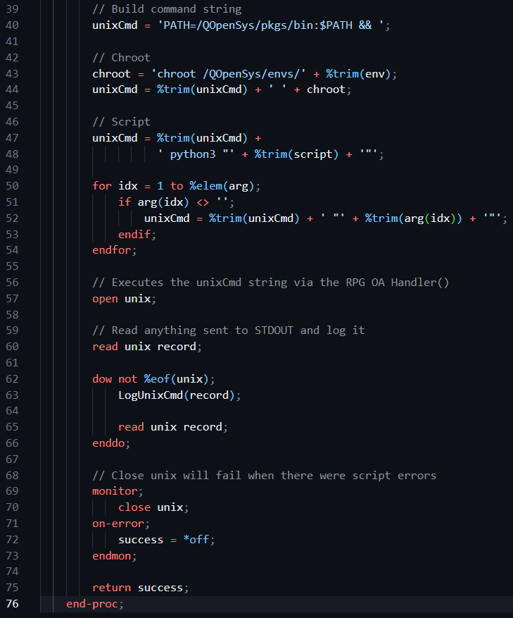
Running Python from RPG (Unix CMD, Chroot, Proc in SRVPGM) Pt 2
Notes:
Part 2 (READ)

Slide 10

Level UP!
Convert Spreadsheets with Pandas
Extract Text with PDF Miner
Currency Exchange Rates with Forex
Date and Time functions with Arrow

Slide 11
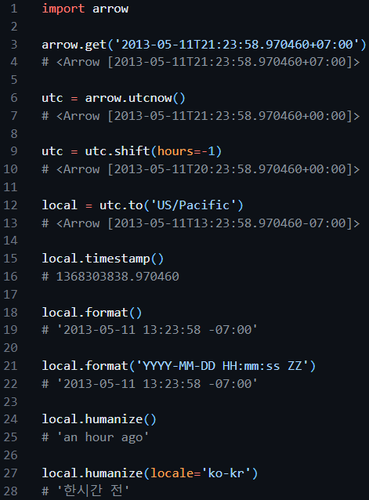
Date and Time functions with Arrow
Notes:
Arrow is a Python library that offers a sensible and human-friendly approach to creating, manipulating, formatting and converting dates, times and timestamps.
(READ)

Slide 12
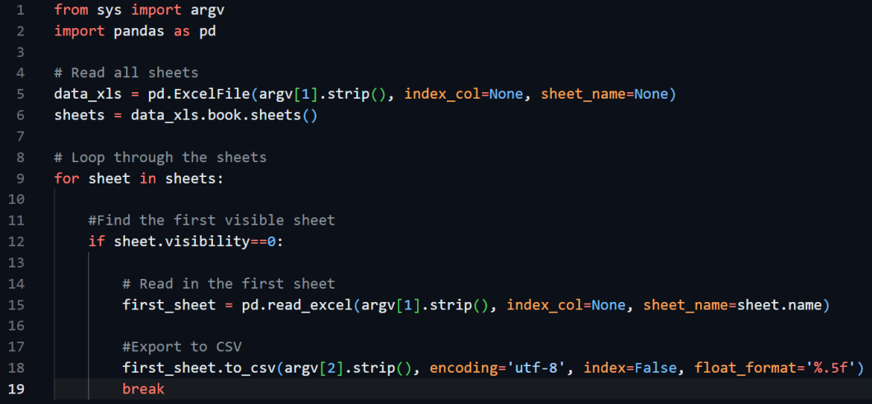
Convert Spreadsheets with pandas
Notes:
So a co-worker came up to me and asked “Hey Joe, can you help me with a spreadsheet problem. Maybe use some of that python magic?”
He was getting XLS files with the first sheet hidden. He needed them in CSV with decimals out to 5 positions. This program took me maybe 10 minutes.
(READ)
Now-
pandas is a fast, powerful, flexible and easy to use data analysis and manipulation tool.
That’s a fancy way of saying it does a whole lot more than this example. There are dedicated packages that will convert between filetypes, but I think it’s a good idea to dip your toes in with pandas as it will serve you a lot more in the future as you become more familiar with it.
Go read their docs!! This example is xls to csv. There’s also to excel (xlsx), to json, to html, to markdown, and a half dozen other more advanced options!
**Mention ARGV**

Slide 13
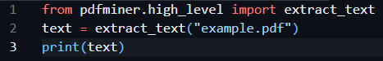
Extract Text with pdf-miner
Yeah, that’s it.
Notes:
Pdfminer.six is a community maintained fork of the original PDFMiner. It is a tool for extracting information from PDF documents. It focuses on getting and analyzing text data.
(READ)
Dead simple example of a package doing exactly what it says on the tin. Of course there are a million customization options Go read the docs!

Slide 14
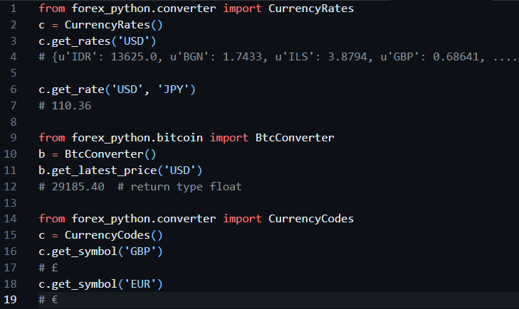
Currency Exchange Rates with forex
Notes:
Free Foreign exchange rates, bitcoin prices and currency conversion.

Slide 15

So You Want to Be a Wizard? Level Up!
Validation
JSON
Phone #s
Emails
URLs
Coordinates
Arguments
ArgParse
Python Fire

Slide 16
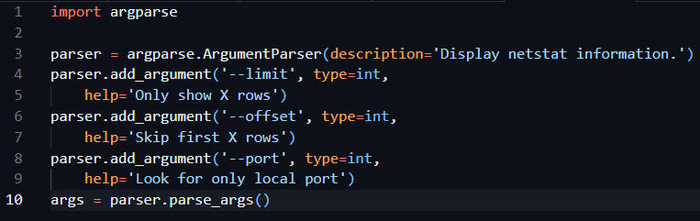
Argument Parsing with argparse
Thanks Club-Seiden & ThePrez!
Notes:
The argparse module makes it easy to write user-friendly command-line interfaces.
This example I lovingly stole from Jesse’s repository of ibmi-oss-examples which I believe he, also lovingly, stole from Club-Seiden. Remember sharing is caring.
(READ)
Calling this programs are as simple as your_pythonfile.py --limit 10 --offset 50 --port 25

Slide 17
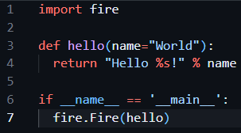
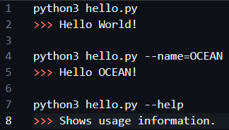
Argument Magic with python-fire
Notes:
A package from Google
Python Fire is a library for automatically generating command line interfaces (CLIs) from absolutely any Python object.
It’s magic works best when you have functions and classes defined. Above is a very simple example, but show’s how lazy (aka productive) you can be in case you were worried when I showed you that last slide on ArgParse.
(READ Code)
If __name__ == __main__ is a special expression in python to say only run this code if run directly. Don’t run it when imported as a module. You will see this a lot when you are making modules with classes and functions. Often you want to use those in other programs so you import them instead of calling them directly. In this case we want to fire fire hello so that’s why that code is here.
(READ Output)

Slide 18
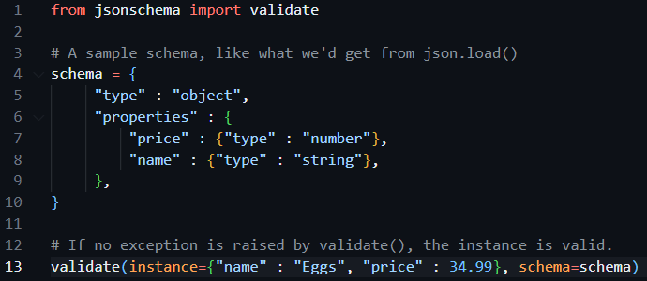
Validate your JSON with jsonschema
Notes:
JSON Schema is a declarative language that allows you to annotate and validate JSON documents.
(READ)
** note ** Json parse (string to json), Json stringify (json to string) Json.load() json file
Expensive eggs these must’ve been on sell earlier this year.

Slide 19
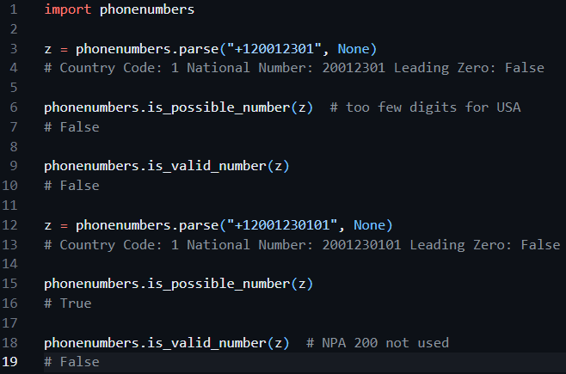
Validate Phone #s with python-phonenumbers
Notes:
Validates phone numbers
Does what it says on the tin
(READ)

Slide 20
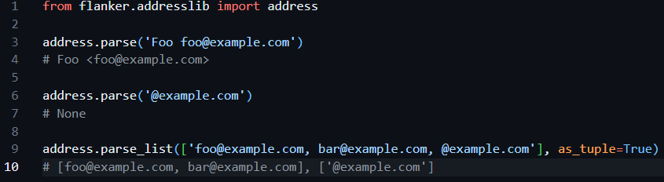
Validate Emails with flanker
Notes:
Flanker is an open source parsing library written in Python by the Mailgun Team. Flanker currently consists of an address parsing library (flanker.addresslib) as well as a MIME parsing library (flanker.mime).
(READ)
You don’t have to learn: RFC5322, RFC1034, 1035, 1123, 5321… 362 pages of light reading to truly validate your emails. A valid email address is a little more complicated than name @ domain.com and you know what? You don’t need to know any of that. The package also supports parsing full MIME messages.

Slide 21
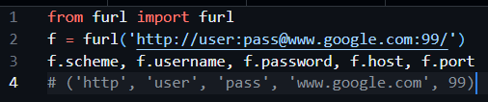
Validate URLs with furl
Notes:
furl is a small Python library that makes parsing and manipulating URLs easy.
(READ)
URLs are also deceptively simple until you start researching them, but again that’s the power of python libraries you don’t need to if you find trusted packages that have done that hard work for you.

Slide 22
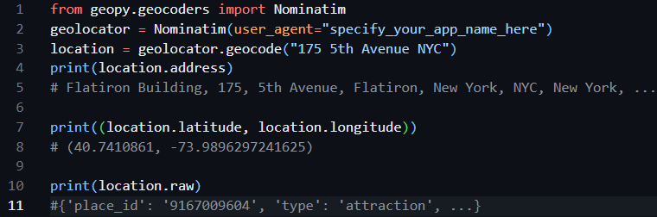
Validate Coordinates with geopy
Notes:
geopy is a Python client for several popular geocoding web services.
geopy makes it easy for Python developers to locate the coordinates of addresses, cities, countries, and landmarks across the globe using third-party geocoders and other data sources.
OpenStreetMap (ABOVE), Google Geocoding, and many others.
(READ)
**note** raw is output from geocoding api

Slide 23
It is pitch black. You are likely to be eaten by a Grue.
Zork

Slide 24
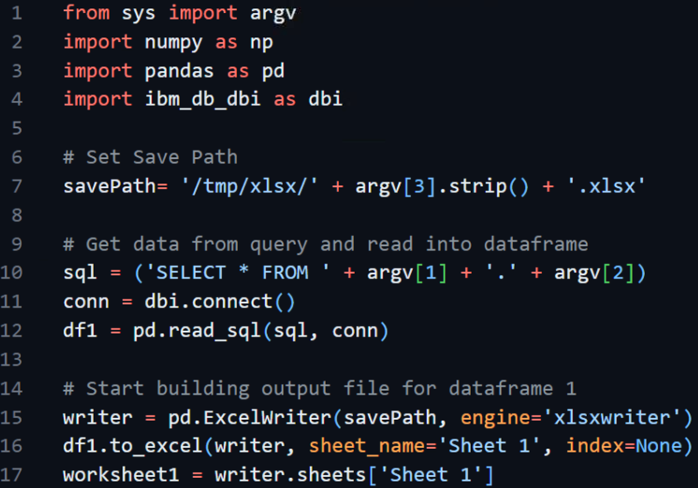
🐼 Pt 1 More Pandas PF to XLSX Arg1: Library Arg2: Table Arg3: Filename
Notes:
(READ)

Slide 25
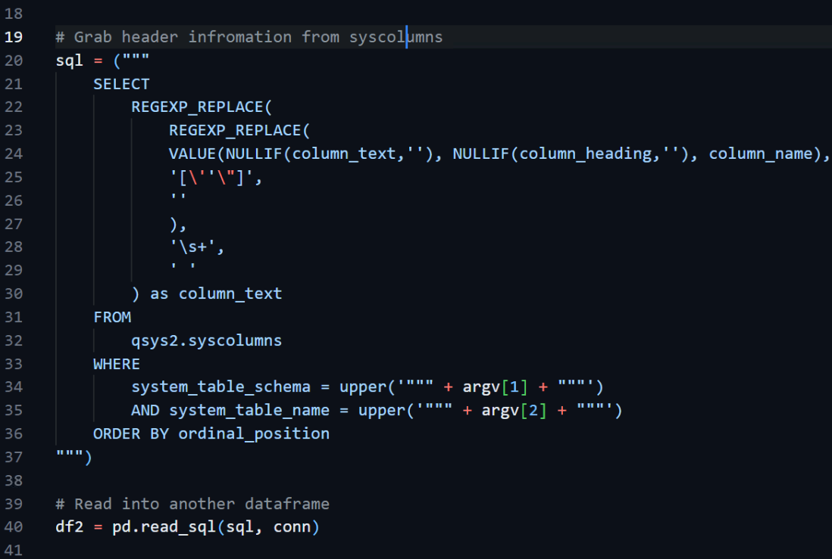
🐼 Pt 2
Notes:
(READ)

Slide 26
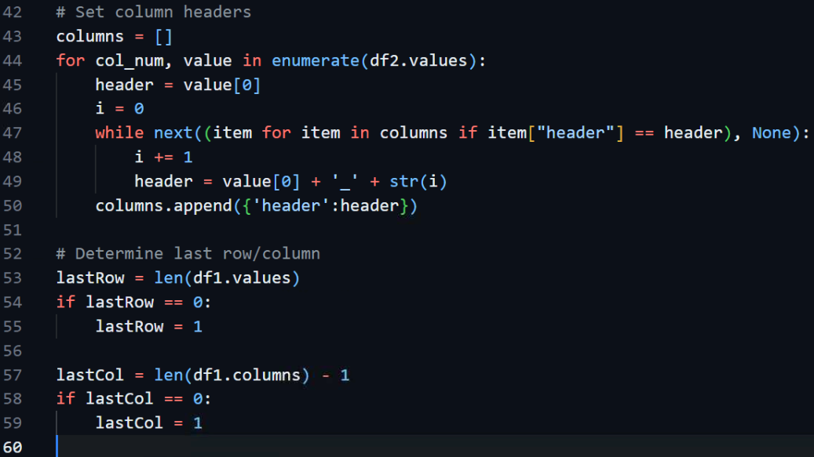
🐼 Pt 3
Notes:
(READ)

Slide 27
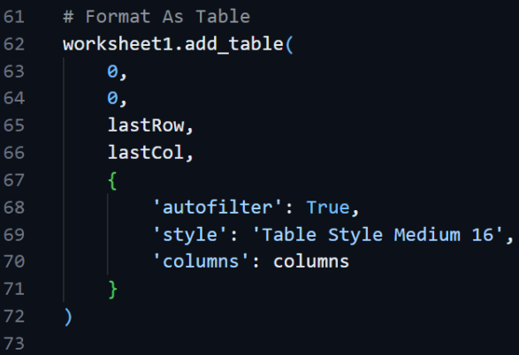
🐼 Pt 4
Notes:
(READ)

Slide 28
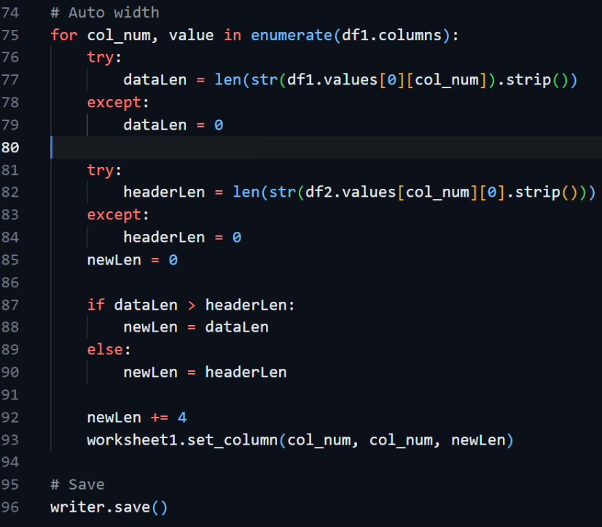
🐼 Pt 5
Notes:
(READ)

Slide 29
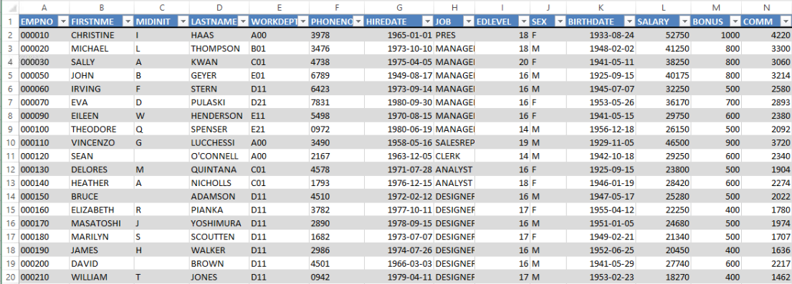
🐼 Pt 6 The Results!
Notes:
A nice fully formatted XLSX file with a real table, column filters, auto-sized columns, column headers auto defined from syscolumns.

Slide 30




Expansion Packs
Authentication
APIs
Web Scraping
OCR
oauthlib
pyjwt
fastapi
boto3
google-api-client
scrapy
lassie
opencv
pytesseract
Notes:
Here’s some awesome packages I didn’t talk about today that I’ve used that saved me days and days of work.
(READ)
***SEGUE***
You know how they say “A magician never reveals his secrets?” Well I’m not a magician so here are all my secrets.

Slide 31
Continuing your Quest
Links
https://www.python.org/doc/
https://github.com/gto76/python-cheatsheet
https://code.visualstudio.com/
https://ibm.github.io/ibmi-oss-resources/
https://github.com/vinta/awesome-python

Slide 32
References
https://git-scm.com/downloads
https://www.scottklement.com/unixcmd/
https://github.com/IBM/ibmichroot/
https://github.com/arrow-py/arrow
https://github.com/pdfminer/pdfminer.six
https://github.com/pandas-dev/pandas
https://github.com/MicroPyramid/forex-python
https://github.com/google/python-fire
https://docs.python.org/3/library/argparse.html
https://github.com/python-jsonschema/jsonschema
https://github.com/daviddrysdale/python-phonenumbers
https://github.com/mailgun/flanker
https://github.com/gruns/furl
https://github.com/geopy/geopy

Slide 33

Thank you
Joseph Wright
@Wright4i
https://wright4i.com
Notes:
Github and Ocean will be updated with these slides soon!

